Slide 1

Chapter 6
Graphical User Interfaces

Slide 2
Chapter Scope
GUI components, events, and listeners
Containers
Buttons, text fields, sliders, combo boxes
Layout managers
Mouse and keyboard events
Dialog boxes
Borders, tool tips, and mnemonics

Slide 3
GUI Elements
Examples from previous chapters are known as command-line applications, which interact with the user through simple prompts and feedback
Command-line applications lack the rich user experience
With graphical user interfaces (GUI), the user is not limited to responding to prompts in a particular order and receiving feedback in one place

Slide 4
GUI Elements
Three kinds of objects are needed to create a GUI in Java:
components
events
listeners
Component – an object that defines a screen element used to display information or allow the user to interact with the program
A container is a special type of component that is used to hold and organize other components

Slide 5
GUI Elements
Event – an object that represents some occurrence in which we may be interested
Often correspond to user actions (mouse button press, keyboard key press)
Most GUI components generate events to indicate a user action related to that component
Program that is oriented around GUI, responding to user events is called event-driven

Slide 6
GUI Elements
Listener – an object that “waits” for an event to occur and responds in way when it does
In designing a GUI-based program we need to establish the relationships between the listener, the event it listens for, and the component that generates the event
It's common to use existing components and events from the Java class library.
We will, however, write our own listener classes to perform whatever actions we desire when events occur

Slide 7
GUI Elements
To create a Java program that uses a GUI, we must:
instantiate and set up the necessary components,
implement listener classes that define what happens when particular events occur, and
establish the relationship between the listeners and the components that generate the events of interest
Java components and other GUI-related classes are defined primarily in two packages
java.awt
javax.swing

Slide 8
GUI Elements
The Abstract Window Toolkit (AWT) was the original Java GUI package
contains many important classes we will use
The Swing package was added later
provides components that are more versatile than those of AWT
Let’s look at a simple example that contains all of the basic GUI elements
the example presents the user with a single push button
each time the button is pushed, a counter is updated and displayed

Slide 9

PushCounter Example
Let’s look at a simple example that contains all of the basic GUI elements
the example presents the user with a single push button
each time the button is pushed, a counter is updated and displayed

Slide 10
//********************************************************************
// PushCounter.java Java Foundations
//
// Demonstrates a graphical user interface and an event listener.
//********************************************************************
import javax.swing.JFrame;
public class PushCounter
{
//-----------------------------------------------------------------
// Creates and displays the main program frame.
//-----------------------------------------------------------------
public static void main(String[] args)
{
JFrame frame = new JFrame("Push Counter");
frame.setDefaultCloseOperation(JFrame.EXIT_ON_CLOSE);
PushCounterPanel panel = new PushCounterPanel();
frame.getContentPane().add(panel);
frame.pack();
frame.setVisible(true);
}
}

Slide 11
//********************************************************************
// PushCounterPanel.java Java Foundations
//
// Demonstrates a graphical user interface and an event listener.
//********************************************************************
import java.awt.*;
import java.awt.event.*;
import javax.swing.*;
public class PushCounterPanel extends JPanel
{
private int count;
private JButton push;
private JLabel label;
//-----------------------------------------------------------------
// Constructor: Sets up the GUI.
//-----------------------------------------------------------------
public PushCounterPanel()
{
count = 0;
push = new JButton("Push Me!");
push.addActionListener(new ButtonListener());

Slide 12
add(push);
add(label);
setBackground(Color.cyan);
setPreferredSize(new Dimension(300, 40));
}
//*****************************************************************
// Represents a listener for button push (action) events.
//*****************************************************************
private class ButtonListener implements ActionListener
{
//--------------------------------------------------------------
// Updates the counter and label when the button is pushed.
//--------------------------------------------------------------
public void actionPerformed(ActionEvent event)
{
count++;
label.setText("Pushes: " + count);
}
}
}

Slide 13
Frames and Panels
We classify containers as either
heavyweight – managed by the underlying operating system
examples: a frame, an applet (used to display and execute a Java application through a Web browser)
lightweight – managed by the Java program
example: a panel
more complex than heavyweight containers
We'll often create a GUI-based application by creating a frame the contains a panel

Slide 14
PushCounter Example
In the main method, the frame for the program is constructed, set up, and displayed
The call to the setDefaultCloseOperation method determines what will happen when the close button in the corner of the frame is clicked
The content pane of the frame is obtained using the getContentPane method
The content pane’s add method is used to add the panel

Slide 15
PushCounter Example
The panel contains our button and text label
A panel’s add method allows a component to be added to the panel
A container is governed by a layout manager
The default layout manager for a panel simply displays components in the order they are added, with as many components on one line as possible
The pack method of the frame sets the frame size accordingly

Slide 16
PushCounter Example
The components:
label - displays a line of text
can be used to also display an image
labels are non-interactive
push button – allows the user to initiate an action with a press of the mouse
generates an action event
different components generate different types of events
The ButtonListener class represents the action listener for the button

Slide 17
PushCounter Example
ButtonListener class was created as an inner class – a class defined inside of another class
Inner classes have access to the members of the class that contains it
Listener classes are written by implementing an interface (list of methods the implementing class must implement)
The ButtonListener implements the ActionListener interface

Slide 18
PushCounter Example
ActionListener interface
only method listed is the actionPerformed method
the button component generates the action event resulting in a call to the actionPerformed method, passing an ActionEvent object
In the example, when the event occurs, the counter is incremented, and the label is updated (via the label’s setText method)

Slide 19
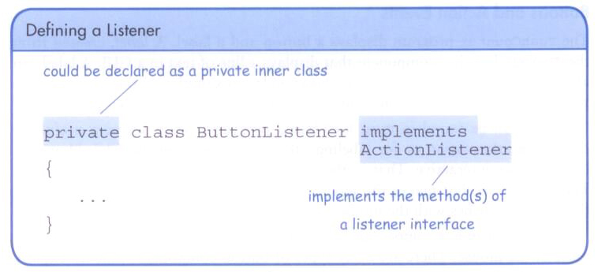
Defining a Listener

Slide 20
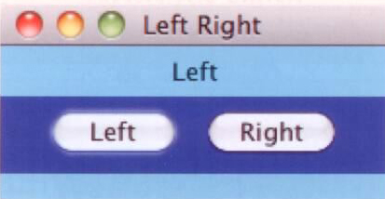
Determining Event Sources
In the next example, we use one listener to listen to two different components
The example contains one label and two buttons
when the Left button is pushed, the label displays “Left”
when the Right button is pushed, the label displays “Right”

Slide 21
Determining Event Sources
The LeftRightPanel class creates one listener and applies it to both buttons
When either button is pressed, the actionPerfomed method of the listener is invoked.
The getSource method returns a reference to the component that generated the event
We could have created two listener classes. Then the actionPerformed method would not have to determine where the event is originating

Slide 22
//********************************************************************
// LeftRight.java Java Foundations
//
// Demonstrates the use of one listener for multiple buttons.
//********************************************************************
import javax.swing.JFrame;
public class LeftRight
{
//-----------------------------------------------------------------
// Creates and displays the main program frame.
//-----------------------------------------------------------------
public static void main(String[] args)
{
JFrame frame = new JFrame("Left Right");
frame.setDefaultCloseOperation(JFrame.EXIT_ON_CLOSE);
frame.getContentPane().add(new LeftRightPanel());
frame.pack();
frame.setVisible(true);
}
}

Slide 23
//********************************************************************
// LeftRightPanel.java Java Foundations
//
// Demonstrates the use of one listener for multiple buttons.
//********************************************************************
import java.awt.*;
import java.awt.event.*;
import javax.swing.*;
public class LeftRightPanel extends JPanel
{
private JButton left, right;
private JLabel label;
private JPanel buttonPanel;
//-----------------------------------------------------------------
// Constructor: Sets up the GUI.
//-----------------------------------------------------------------
public LeftRightPanel()
{
left = new JButton("Left");
right = new JButton("Right");
ButtonListener listener = new ButtonListener();
left.addActionListener(listener);
right.addActionListener(listener);
label = new JLabel("Push a button");

Slide 24
buttonPanel = new JPanel();
buttonPanel.setPreferredSize(new Dimension(200, 40));
buttonPanel.setBackground(Color.blue);
buttonPanel.add(left);
buttonPanel.add(right);
setPreferredSize(new Dimension(200, 80));
setBackground(Color.cyan);
add(label);
add(buttonPanel);
}
//*****************************************************************
// Represents a listener for both buttons.
//*****************************************************************
private class ButtonListener implements ActionListener
{
//--------------------------------------------------------------
// Determines which button was pressed and sets the label
// text accordingly.
//--------------------------------------------------------------
public void actionPerformed(ActionEvent event)
{
if (event.getSource() == left)
label.setText("Left");
else
label.setText("Right");
}
}
}

Slide 25
More Components
In addition to push buttons, there are variety of other interactive components
text fields – allows the user to enter typed input from the keyboard
check boxes – a button that can be toggled on or off using the mouse (indicates a boolean value is set or unset)
radio buttons – used with other radio buttons to provide a set of mutually exclusive options
sliders – allows the user to specify a numeric value within a bounded range
combo boxes – allows the user to select one of several options from a “drop down” menu
timers – helps us manage an activity over time, has no visual representation

Slide 26
Text Fields
A text field generates an action event when the Enter or Return key is pressed (and the cursor is in the field)
Note that the push button and the text field generate the same kind of event – an action event
An alternative implementation could involve adding a push button to the panel which causes the conversion to occur when the user pushes the button

Slide 27
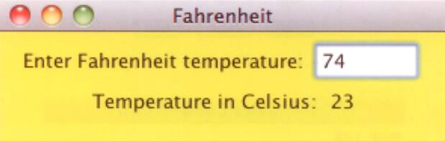
Fahrenheit Example
The Fahrenheit example uses three labels and text field
When a temperature is entered in the text field (and the return button pressed), the corresponding Celsius temperature is displayed

Slide 28
//********************************************************************
// Fahrenheit.java Java Foundations
//
// Demonstrates the use of text fields.
//********************************************************************
import javax.swing.JFrame;
public class Fahrenheit
{
//-----------------------------------------------------------------
// Creates and displays the temperature converter GUI.
//-----------------------------------------------------------------
public static void main(String[] args)
{
JFrame frame = new JFrame("Fahrenheit");
frame.setDefaultCloseOperation(JFrame.EXIT_ON_CLOSE);
FahrenheitPanel panel = new FahrenheitPanel();
frame.getContentPane().add(panel);
frame.pack();
frame.setVisible(true);
}
}

Slide 29
//********************************************************************
// FahrenheitPanel.java Java Foundations
//
// Demonstrates the use of text fields.
//********************************************************************
import java.awt.*;
import java.awt.event.*;
import javax.swing.*;
public class FahrenheitPanel extends JPanel
{
private JLabel inputLabel, outputLabel, resultLabel;
private JTextField fahrenheit;
//-----------------------------------------------------------------
// Constructor: Sets up the main GUI components.
//-----------------------------------------------------------------
public FahrenheitPanel()
{
inputLabel = new JLabel("Enter Fahrenheit temperature:");
outputLabel = new JLabel("Temperature in Celsius: ");
resultLabel = new JLabel("---");
fahrenheit = new JTextField(5);
fahrenheit.addActionListener(new TempListener());

Slide 30
add(inputLabel);
add(fahrenheit);
add(outputLabel);
add(resultLabel);
setPreferredSize(new Dimension(300, 75));
setBackground(Color.yellow);
}
//*****************************************************************
// Represents an action listener for the temperature input field.
//*****************************************************************
private class TempListener implements ActionListener
{
//--------------------------------------------------------------
// Performs the conversion when the enter key is pressed in
// the text field.
//--------------------------------------------------------------
public void actionPerformed(ActionEvent event)
{
int fahrenheitTemp, celsiusTemp;
String text = fahrenheit.getText();
fahrenheitTemp = Integer.parseInt(text);
celsiusTemp = (fahrenheitTemp-32) * 5/9;
resultLabel.setText(Integer.toString(celsiusTemp));
}
}
}

Slide 31
Check Boxes
A check box generates an item event when it changes state from selected (checked) to deselected (unchecked) and vice versa
The JCheckBox class is used to define check boxes
In the example, we use the same listener to handle both check boxes (bold and italic)
The example also uses the Font class to display and change the text label
The font style is represented as an integer using constants defined in the class

Slide 32
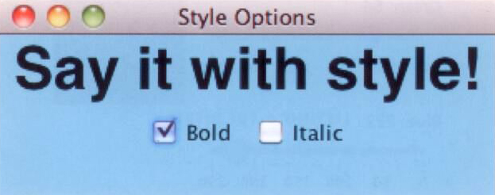
StyleOptions Example
The phrase is displayed in regular font style, bold, italic, or both, depending on which check boxes are selected

Slide 33
//********************************************************************
// StyleOptions.java Java Foundations
//
// Demonstrates the use of check boxes.
//********************************************************************
import javax.swing.JFrame;
public class StyleOptions
{
//-----------------------------------------------------------------
// Creates and displays the style options frame.
//-----------------------------------------------------------------
public static void main(String[] args)
{
JFrame frame = new JFrame("Style Options");
frame.setDefaultCloseOperation(JFrame.EXIT_ON_CLOSE);
frame.getContentPane().add(new StyleOptionsPanel());
frame.pack();
frame.setVisible(true);
}
}

Slide 34
//********************************************************************
// StyleOptionsPanel.java Java Foundations
//
// Demonstrates the use of check boxes.
//********************************************************************
import javax.swing.*;
import java.awt.*;
import java.awt.event.*;
public class StyleOptionsPanel extends JPanel
{
private JLabel saying;
private JCheckBox bold, italic;
//-----------------------------------------------------------------
// Sets up a panel with a label and some check boxes that
// control the style of the label's font.
//-----------------------------------------------------------------
public StyleOptionsPanel()
{
saying = new JLabel("Say it with style!");
saying.setFont(new Font("Helvetica", Font.PLAIN, 36));
bold = new JCheckBox("Bold");
bold.setBackground(Color.cyan);
italic = new JCheckBox("Italic");
italic.setBackground(Color.cyan);
StyleListener listener = new StyleListener();
bold.addItemListener(listener);
italic.addItemListener(listener);

Slide 35
add(saying);
add(bold);
add(italic);
setBackground(Color.cyan);
setPreferredSize(new Dimension(300, 100));
}
//*****************************************************************
// Represents the listener for both check boxes.
//*****************************************************************
private class StyleListener implements ItemListener
{
//--------------------------------------------------------------
// Updates the style of the label font style.
//--------------------------------------------------------------
public void itemStateChanged(ItemEvent event)
{
int style = Font.PLAIN;
if (bold.isSelected())
style = Font.BOLD;
if (italic.isSelected())
style += Font.ITALIC;
saying.setFont(new Font("Helvetica", style, 36));
}
}
}

Slide 36
Radio Buttons
A radio button is used with other radio buttons to provide a set of mutually exclusive options
Radio buttons have meaning only when used with one or more other radio buttons
At any point in time, only one button of the group is selected (on)
Radio buttons produce an action event when selected
Radio buttons are defined by the JRadioButton class
The ButtonGroup class is used to define a set of related radio buttons

Slide 37
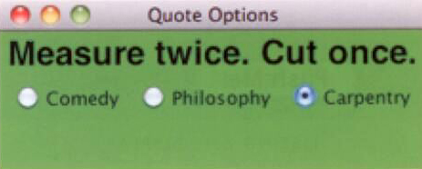
QuoteOptions Example
A different quote is displayed depending on which radio button is selected
Since only one quote is displayed at any time, mutually-exclusive radio buttons are used

Slide 38
//********************************************************************
// QuoteOptions.java Java Foundations
//
// Demonstrates the use of radio buttons.
//********************************************************************
import javax.swing.JFrame;
public class QuoteOptions
{
//-----------------------------------------------------------------
// Creates and presents the program frame.
//-----------------------------------------------------------------
public static void main(String[] args)
{
JFrame frame = new JFrame("Quote Options");
frame.setDefaultCloseOperation(JFrame.EXIT_ON_CLOSE);
frame.getContentPane().add(new QuoteOptionsPanel());
frame.pack();
frame.setVisible(true);
}
}

Slide 39
//********************************************************************
// QuoteOptionsPanel.java Java Foundations
//
// Demonstrates the use of radio buttons.
//********************************************************************
import javax.swing.*;
import java.awt.*;
import java.awt.event.*;
public class QuoteOptionsPanel extends JPanel
{
private JLabel quote;
private JRadioButton comedy, philosophy, carpentry;
private String comedyQuote, philosophyQuote, carpentryQuote;
//-----------------------------------------------------------------
// Sets up a panel with a label and a set of radio buttons
// that control its text.
//-----------------------------------------------------------------
public QuoteOptionsPanel()
{
comedyQuote = "Take my wife, please.";
philosophyQuote = "I think, therefore I am.";
carpentryQuote = "Measure twice. Cut once.";
quote = new JLabel(comedyQuote);
quote.setFont(new Font("Helvetica", Font.BOLD, 24));

Slide 40
comedy = new JRadioButton("Comedy", true);
comedy.setBackground(Color.green);
philosophy = new JRadioButton("Philosophy");
philosophy.setBackground(Color.green);
carpentry = new JRadioButton("Carpentry");
carpentry.setBackground(Color.green);
ButtonGroup group = new ButtonGroup();
group.add(comedy);
group.add(philosophy);
group.add(carpentry);
QuoteListener listener = new QuoteListener();
comedy.addActionListener(listener);
philosophy.addActionListener(listener);
carpentry.addActionListener(listener);
add(quote);
add(comedy);
add(philosophy);
add(carpentry);
setBackground(Color.green);
setPreferredSize(new Dimension(300, 100));
}

Slide 41
//*****************************************************************
// Represents the listener for all radio buttons
//*****************************************************************
private class QuoteListener implements ActionListener
{
//--------------------------------------------------------------
// Sets the text of the label depending on which radio
// button was pressed.
//--------------------------------------------------------------
public void actionPerformed(ActionEvent event)
{
Object source = event.getSource();
if (source == comedy)
quote.setText(comedyQuote);
else
if (source == philosophy)
quote.setText(philosophyQuote);
else
quote.setText(carpentryQuote);
}
}
}

Slide 42
Sliders
Sliders allow the user to specify a numeric value within a bounded range
A slider can be presented either vertically or horizontally
Optional features include
tick marks on the slider
labels indicating the range of values
A slider produces a change event, indicating that the position of the slider and the value it represents has changed
A slider is defined by the JSlider class

Slide 43
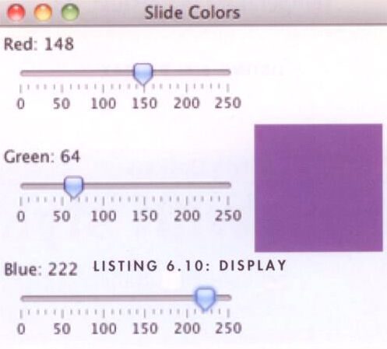
SlideColors Example
The color corresponding to the values of the three sliders is shown in the small panel on the right

Slide 44
//********************************************************************
// SlideColor.java Java Foundations
//
// Demonstrates the use slider components.
//********************************************************************
import java.awt.*;
import javax.swing.*;
public class SlideColor
{
//-----------------------------------------------------------------
// Presents a frame with a control panel and a panel that
// changes color as the sliders are adjusted.
//-----------------------------------------------------------------
public static void main(String[] args)
{
JFrame frame = new JFrame("Slide Colors");
frame.setDefaultCloseOperation(JFrame.EXIT_ON_CLOSE);
frame.getContentPane().add(new SlideColorPanel());
frame.pack();
frame.setVisible(true);
}
}

Slide 45
//********************************************************************
// SlideColorPanel.java Java Foundations
//
// Represents the slider control panel for the SlideColor program.
//********************************************************************
import java.awt.*;
import javax.swing.*;
import javax.swing.event.*;
public class SlideColorPanel extends JPanel
{
private JPanel controls, colorPanel;
private JSlider rSlider, gSlider, bSlider;
private JLabel rLabel, gLabel, bLabel;
//-----------------------------------------------------------------
// Sets up the sliders and their labels, aligning them along
// their left edge using a box layout.
//-----------------------------------------------------------------
public SlideColorPanel()
{
rSlider = new JSlider(JSlider.HORIZONTAL, 0, 255, 0);
rSlider.setMajorTickSpacing(50);
rSlider.setMinorTickSpacing(10);
rSlider.setPaintTicks(true);
rSlider.setPaintLabels(true);
rSlider.setAlignmentX(Component.LEFT_ALIGNMENT);

Slide 46
gSlider = new JSlider(JSlider.HORIZONTAL, 0, 255, 0);
gSlider.setMajorTickSpacing(50);
gSlider.setMinorTickSpacing(10);
gSlider.setPaintTicks(true);
gSlider.setPaintLabels(true);
gSlider.setAlignmentX(Component.LEFT_ALIGNMENT);
bSlider = new JSlider(JSlider.HORIZONTAL, 0, 255, 0);
bSlider.setMajorTickSpacing(50);
bSlider.setMinorTickSpacing(10);
bSlider.setPaintTicks(true);
bSlider.setPaintLabels(true);
bSlider.setAlignmentX(Component.LEFT_ALIGNMENT);
SliderListener listener = new SliderListener();
rSlider.addChangeListener(listener);
gSlider.addChangeListener(listener);
bSlider.addChangeListener(listener);
rLabel = new JLabel("Red: 0");
rLabel.setAlignmentX(Component.LEFT_ALIGNMENT);
gLabel = new JLabel("Green: 0");
gLabel.setAlignmentX(Component.LEFT_ALIGNMENT);
bLabel = new JLabel("Blue: 0");
bLabel.setAlignmentX(Component.LEFT_ALIGNMENT);
controls = new JPanel();
BoxLayout layout = new BoxLayout(controls, BoxLayout.Y_AXIS);
controls.setLayout(layout);

Slide 47
controls.add(rLabel);
controls.add(rSlider);
controls.add(Box.createRigidArea(new Dimension (0, 20)));
controls.add(gLabel);
controls.add(gSlider);
controls.add(Box.createRigidArea(new Dimension (0, 20)));
controls.add(bLabel);
controls.add(bSlider);
colorPanel = new JPanel();
colorPanel.setPreferredSize(new Dimension(100, 100));
colorPanel.setBackground(new Color(0, 0, 0));
add(controls);
add(colorPanel);
}
//*****************************************************************
// Represents the listener for all three sliders.
//*****************************************************************
private class SliderListener implements ChangeListener
{
private int red, green, blue;

Slide 48
//--------------------------------------------------------------
// Gets the value of each slider, then updates the labels and
// the color panel.
//--------------------------------------------------------------
public void stateChanged(ChangeEvent event)
{
red = rSlider.getValue();
green = gSlider.getValue();
blue = bSlider.getValue();
rLabel.setText("Red: " + red);
gLabel.setText("Green: " + green);
bLabel.setText("Blue: " + blue);
colorPanel.setBackground(new Color(red, green, blue));
}
}
}

Slide 49
Combo Boxes
A combo box allows a user to select one of several options from a “drop down” menu
When the user presses a combo box using a mouse, a list of options is displayed from which the user can choose
A combo box is defined by the JComboBox class
Combo boxes generate an action event whenever the user makes a selection from it

Slide 50
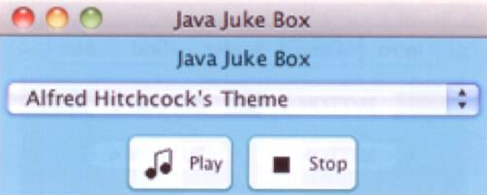
JavaJukeBox Example
The user can select a song using the combo box, then play and stop the song using buttons

Slide 51
//********************************************************************
// JukeBox.java Java Foundations
//
// Demonstrates the use of a combo box.
//********************************************************************
import javax.swing.*;
public class JukeBox
{
//-----------------------------------------------------------------
// Creates and displays the controls for a juke box.
//-----------------------------------------------------------------
public static void main(String[] args)
{
JFrame frame = new JFrame("Java Juke Box");
frame.setDefaultCloseOperation(JFrame.EXIT_ON_CLOSE);
frame.getContentPane().add(new JukeBoxControls());
frame.pack();
frame.setVisible(true);
}
}

Slide 52
//********************************************************************
// JukeBoxControls.java Java Foundations
//
// Represents the control panel for the juke box.
//********************************************************************
import java.awt.*;
import java.awt.event.*;
import javax.swing.*;
import java.applet.AudioClip;
import java.net.URL;
public class JukeBoxControls extends JPanel
{
private JComboBox musicCombo;
private JButton stopButton, playButton;
private AudioClip[] music;
private AudioClip current;
//-----------------------------------------------------------------
// Sets up the GUI for the juke box.
//-----------------------------------------------------------------
public JukeBoxControls()
{
URL url1, url2, url3, url4, url5, url6;
url1 = url2 = url3 = url4 = url5 = url6 = null;

Slide 53
// Obtain and store the audio clips to play
try
{
url1 = new URL("file", "localhost", "westernBeat.wav");
url2 = new URL("file", "localhost", "classical.wav");
url3 = new URL("file", "localhost", "jeopardy.au");
url4 = new URL("file", "localhost", "newAgeRythm.wav");
url5 = new URL("file", "localhost", "eightiesJam.wav");
url6 = new URL("file", "localhost", "hitchcock.wav");
}
catch (Exception exception) {}
music = new AudioClip[7];
music[0] = null; // Corresponds to "Make a Selection..."
music[1] = JApplet.newAudioClip(url1);
music[2] = JApplet.newAudioClip(url2);
music[3] = JApplet.newAudioClip(url3);
music[4] = JApplet.newAudioClip(url4);
music[5] = JApplet.newAudioClip(url5);
music[6] = JApplet.newAudioClip(url6);
// Create the list of strings for the combo box options
String[] musicNames = {"Make A Selection...", "Western Beat",
"Classical Melody", "Jeopardy Theme", "New Age Rythm",
"Eighties Jam", "Alfred Hitchcock's Theme"};
musicCombo = new JComboBox(musicNames);
musicCombo.setBackground(Color.cyan);

Slide 54
// Set up the buttons
playButton = new JButton("Play", new ImageIcon("play.gif"));
playButton.setBackground(Color.cyan);
stopButton = new JButton("Stop", new ImageIcon("stop.gif"));
stopButton.setBackground(Color.cyan);
// Set up this panel
setPreferredSize(new Dimension (250, 100));
setBackground(Color.cyan);
add(musicCombo);
add(playButton);
add(stopButton);
musicCombo.addActionListener(new ComboListener());
stopButton.addActionListener(new ButtonListener());
playButton.addActionListener(new ButtonListener());
current = null;
}

Slide 55
//*****************************************************************
// Represents the action listener for the combo box.
//*****************************************************************
private class ComboListener implements ActionListener
{
//--------------------------------------------------------------
// Stops playing the current selection (if any) and resets
// the current selection to the one chosen.
//--------------------------------------------------------------
public void actionPerformed(ActionEvent event)
{
if (current != null)
current.stop();
current = music[musicCombo.getSelectedIndex()];
}
}

Slide 56
//*****************************************************************
// Represents the action listener for both control buttons.
//*****************************************************************
private class ButtonListener implements ActionListener
{
//--------------------------------------------------------------
// Stops the current selection (if any) in either case. If
// the play button was pressed, start playing it again.
//--------------------------------------------------------------
public void actionPerformed(ActionEvent event)
{
if (current != null)
current.stop();
if (event.getSource() == playButton)
if (current != null)
current.play();
}
}
}

Slide 57
Timers
Timers do not have a visual representation, but are a AWT component
Timers are defined by the Timer class and are provided to help manage an activity over time
A timer object generates an action event at regular intervals

Slide 58

Rebound Example
When executing, the image bounces around the panel
Whenever the timer expires, the image's position is updated, creating the illusion of movement

Slide 59
//********************************************************************
// Rebound.java Java Foundations
//
// Demonstrates an animation and the use of the Timer class.
//********************************************************************
import java.awt.*;
import java.awt.event.*;
import javax.swing.*;
public class Rebound
{
//-----------------------------------------------------------------
// Displays the main frame of the program.
//-----------------------------------------------------------------
public static void main(String[] args)
{
JFrame frame = new JFrame("Rebound");
frame.setDefaultCloseOperation(JFrame.EXIT_ON_CLOSE);
frame.getContentPane().add(new ReboundPanel());
frame.pack();
frame.setVisible(true);
}
}

Slide 60
//********************************************************************
// ReboundPanel.java Java Foundations
//
// Represents the primary panel for the Rebound program.
//********************************************************************
import java.awt.*;
import java.awt.event.*;
import javax.swing.*;
public class ReboundPanel extends JPanel
{
private final int WIDTH = 300, HEIGHT = 100;
private final int DELAY = 20, IMAGE_SIZE = 35;
private ImageIcon image;
private Timer timer;
private int x, y, moveX, moveY;
//-----------------------------------------------------------------
// Sets up the panel, including the timer for the animation.
//-----------------------------------------------------------------
public ReboundPanel()
{
timer = new Timer(DELAY, new ReboundListener());
image = new ImageIcon("happyFace.gif");

Slide 61
x = 0;
y = 40;
moveX = moveY = 3;
setPreferredSize(new Dimension(WIDTH, HEIGHT));
setBackground(Color.black);
timer.start();
}
//-----------------------------------------------------------------
// Draws the image in the current location.
//-----------------------------------------------------------------
public void paintComponent(Graphics page)
{
super.paintComponent(page);
image.paintIcon(this, page, x, y);
}

Slide 62
//*****************************************************************
// Represents the action listener for the timer.
//*****************************************************************
private class ReboundListener implements ActionListener
{
//--------------------------------------------------------------
// Updates the position of the image and possibly the direction
// of movement whenever the timer fires an action event.
//--------------------------------------------------------------
public void actionPerformed(ActionEvent event)
{
x += moveX;
y += moveY;
if (x <= 0 || x >= WIDTH-IMAGE_SIZE)
moveX = moveX * -1;
if (y <= 0 || y >= HEIGHT-IMAGE_SIZE)
moveY = moveY * -1;
repaint();
}
}
}

Slide 63
Layout Managers
Every container is managed by an object known as a layout manager that determines how the components in the container are arranged visually
The layout manager is consulted when needed, such as when the container is resized or when a component is added
Every container has a default layout manager, but we can replace it if desired
A layout manager determines the size and position of each component

Slide 64
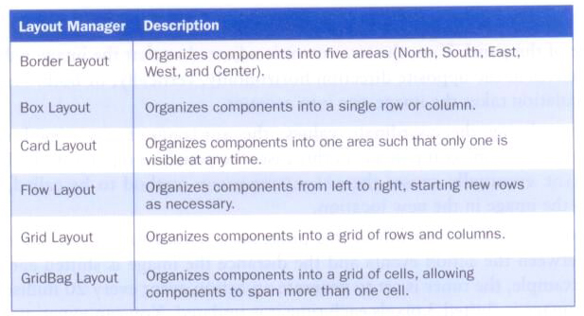
Layout Managers
Some of the layout managers defined in the Java API:

Slide 65
Layout Managers
Every layout manager has its own rules and properties governing the layout of the components it contains
For some layout managers, the order in which you add the components affects their positioning
We use the setLayout method of a container to change its layout manager

Slide 66
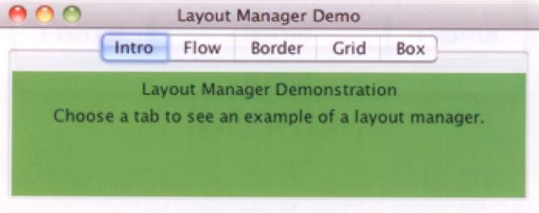
LayoutDemo Example
One program, using a tabbed pane, is used to show the results of various layout managers

Slide 67
//********************************************************************
// LayoutDemo.java Java Foundations
//
// Demonstrates the use of flow, border, grid, and box layouts.
//********************************************************************
import javax.swing.*;
public class LayoutDemo
{
//-----------------------------------------------------------------
// Sets up a frame containing a tabbed pane. The panel on each
// tab demonstrates a different layout manager.
//-----------------------------------------------------------------
public static void main(String[] args)
{
JFrame frame = new JFrame("Layout Manager Demo");
frame.setDefaultCloseOperation(JFrame.EXIT_ON_CLOSE);
JTabbedPane tp = new JTabbedPane();
tp.addTab("Intro", new IntroPanel());
tp.addTab("Flow", new FlowPanel());
tp.addTab("Border", new BorderPanel());
tp.addTab("Grid", new GridPanel());
tp.addTab("Box", new BoxPanel());
frame.getContentPane().add(tp);
frame.pack();
frame.setVisible(true);
}
}

Slide 68
//********************************************************************
// IntroPanel.java Java Foundations
//
// Represents the introduction panel for the LayoutDemo program.
//********************************************************************
import java.awt.*;
import javax.swing.*;
public class IntroPanel extends JPanel
{
//-----------------------------------------------------------------
// Sets up this panel with two labels.
//-----------------------------------------------------------------
public IntroPanel()
{
setBackground(Color.green);
JLabel l1 = new JLabel("Layout Manager Demonstration");
JLabel l2 = new JLabel("Choose a tab to see an example of " +
"a layout manager.");
add(l1);
add(l2);
}
}

Slide 69
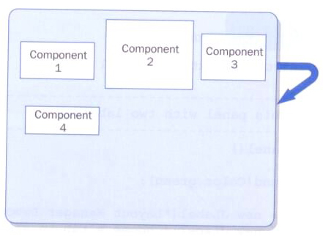
Flow Layout
The JPanel class uses flow layout by default
Puts as many components as possible on a row, at their preferred size
When a component can not fit on a row, it is put on the next row

Slide 70
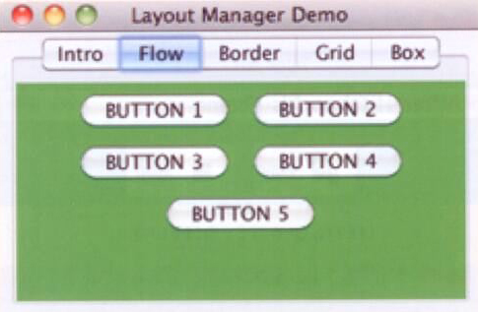
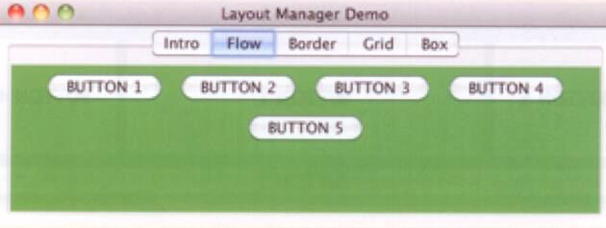
Flow Layout
When the window is resized, the layout manager automatically repositions the buttons

Slide 71
//********************************************************************
// FlowPanel.java Java Foundations
//
// Represents the panel in the LayoutDemo program that demonstrates
// the flow layout manager.
//********************************************************************
import java.awt.*;
import javax.swing.*;
public class FlowPanel extends JPanel
{
//-----------------------------------------------------------------
// Sets up this panel with some buttons to show how flow layout
// affects their position.
//-----------------------------------------------------------------
public FlowPanel()
{
setLayout(new FlowLayout());
setBackground(Color.green);
JButton b1 = new JButton("BUTTON 1");
JButton b2 = new JButton("BUTTON 2");
JButton b3 = new JButton("BUTTON 3");
JButton b4 = new JButton("BUTTON 4");
JButton b5 = new JButton("BUTTON 5");

Slide 72
add(b1);
add(b2);
add(b3);
add(b4);
add(b5);
}
}

Slide 73
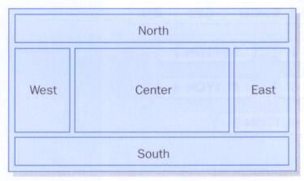
Border Layout
A border layout has five areas to which components can be added: North, South, East, West, and Center

Slide 74
Border Layout
The four outer areas are as large as needed in order to accommodate the component they contain
If no components are added to a region, the region takes up no room in the overall layout
The Center area expands to fill any available space
The size of the gaps between the areas can be adjusted

Slide 75
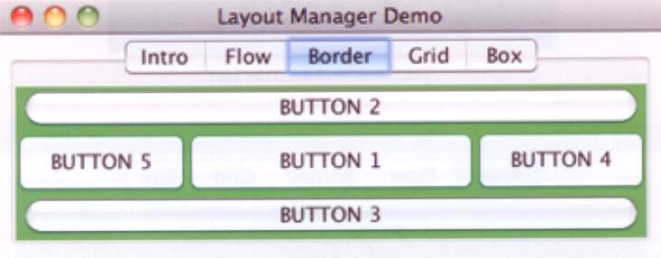
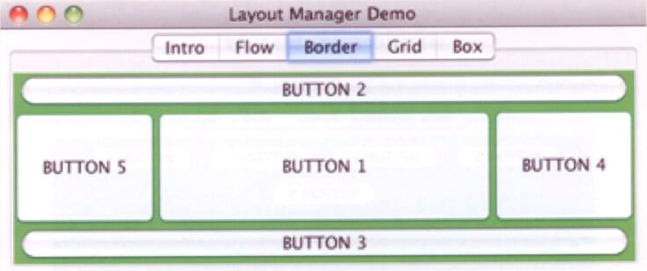
Border Layout

Slide 76
//********************************************************************
// BorderPanel.java Java Foundations
//
// Represents the panel in the LayoutDemo program that demonstrates
// the border layout manager.
//********************************************************************
import java.awt.*;
import javax.swing.*;
public class BorderPanel extends JPanel
{
//-----------------------------------------------------------------
// Sets up this panel with a button in each area of a border
// layout to show how it affects their position, shape, and size.
//-----------------------------------------------------------------
public BorderPanel()
{
setLayout(new BorderLayout());
setBackground(Color.green);
JButton b1 = new JButton("BUTTON 1");
JButton b2 = new JButton("BUTTON 2");
JButton b3 = new JButton("BUTTON 3");
JButton b4 = new JButton("BUTTON 4");
JButton b5 = new JButton("BUTTON 5");

Slide 77
add(b1, BorderLayout.CENTER);
add(b2, BorderLayout.NORTH);
add(b3, BorderLayout.SOUTH);
add(b4, BorderLayout.EAST);
add(b5, BorderLayout.WEST);
}
}

Slide 78
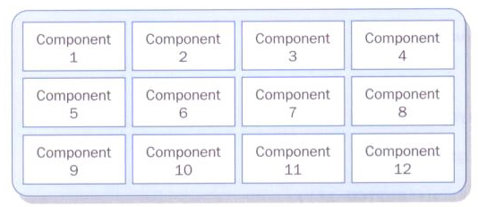
Grid Layout
A grid layout presents a container’s components in a rectangular grid of rows and columns
One component is placed in each cell, and all cells are the same size

Slide 79
Grid Layout
The number of rows and columns in a grid layout is established by using parameters to the constructor when the layout manager is created
As components are added to the grid layout, they fill the grid from left to right, top to bottom
There is no way to explicitly assign a component to a particular location in the grid other than the order in which they are added to the container

Slide 80
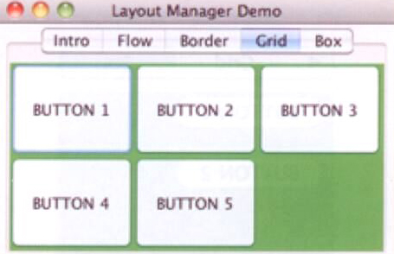
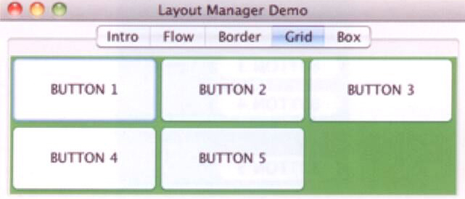
Grid Layout

Slide 81
//********************************************************************
// GridPanel.java Java Foundations
//
// Represents the panel in the LayoutDemo program that demonstrates
// the grid layout manager.
//********************************************************************
import java.awt.*;
import javax.swing.*;
public class GridPanel extends JPanel
{
//-----------------------------------------------------------------
// Sets up this panel with some buttons to show how grid
// layout affects their position, shape, and size.
//-----------------------------------------------------------------
public GridPanel()
{
setLayout(new GridLayout(2, 3));
setBackground(Color.green);
JButton b1 = new JButton("BUTTON 1");
JButton b2 = new JButton("BUTTON 2");
JButton b3 = new JButton("BUTTON 3");
JButton b4 = new JButton("BUTTON 4");
JButton b5 = new JButton("BUTTON 5");

Slide 82
add(b1);
add(b2);
add(b3);
add(b4);
add(b5);
}
}

Slide 83
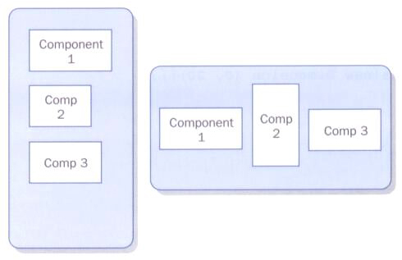
Box Layout
A box layout organizes components either vertically or horizontally, in one row or one column

Slide 84
Box Layout
When combined with other layout managers, box layout can produce complex GUI designs
Components are organized in the order in which they are added to the container
Two types of invisible components can be added to control spacing between other components
rigid areas – with a fixed size
glue – specifies where excess space should go as needed

Slide 85
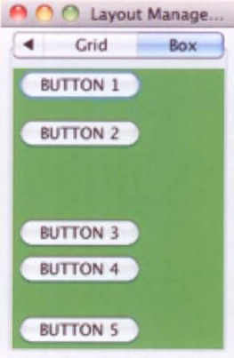
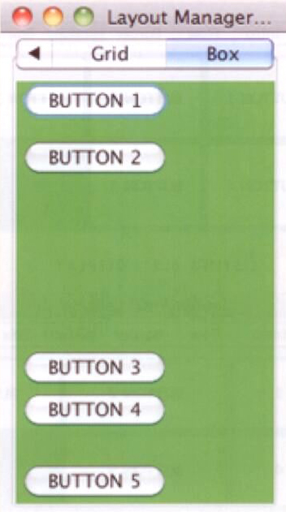
Box Layout

Slide 86
//********************************************************************
// BoxPanel.java Java Foundations
//
// Represents the panel in the LayoutDemo program that demonstrates
// the box layout manager.
//********************************************************************
import java.awt.*;
import javax.swing.*;
public class BoxPanel extends JPanel
{
//-----------------------------------------------------------------
// Sets up this panel with some buttons to show how a vertical
// box layout (and invisible components) affects their position.
//-----------------------------------------------------------------
public BoxPanel()
{
setLayout(new BoxLayout (this, BoxLayout.Y_AXIS));
setBackground(Color.green);
JButton b1 = new JButton("BUTTON 1");
JButton b2 = new JButton("BUTTON 2");
JButton b3 = new JButton("BUTTON 3");
JButton b4 = new JButton("BUTTON 4");
JButton b5 = new JButton("BUTTON 5");

Slide 87
add(b1);
add(Box.createRigidArea(new Dimension (0, 10)));
add(b2);
add(Box.createVerticalGlue());
add(b3);
add(b4);
add(Box.createRigidArea(new Dimension (0, 20)));
add(b5);
}
}

Slide 88
Containment Hierarchies
The way components are grouped into containers, and the way those containers are nested within each other, establishes the containment hierarchy for a GUI
For any Java GUI program, there is generally one primary (top-level) container, such as a frame or applet
The top-level container often contains one or more containers, such as panels
These panels may contain other panels to organize the other components as desired

Slide 89
Mouse and Key Events
In addition to component events, events are also fired when a user interacts with the computer’s mouse and keyboard
Mouse events
mouse events – occur when the user interacts with another component via the mouse. To use, implement the MouseListener interface class
mouse motion events – occur while the mouse is in motion. To use, implement the MouseMotionListener interface class

Slide 90
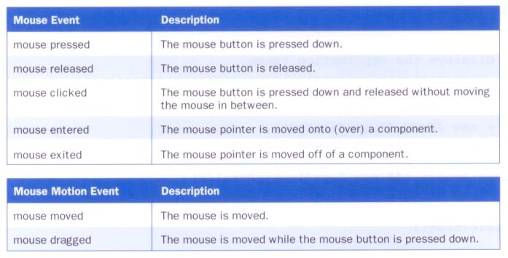
Mouse and Mouse Motion Events

Slide 91
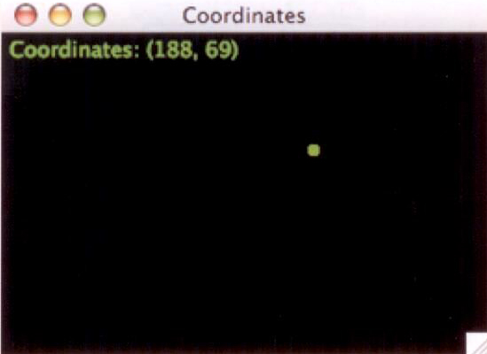
Coordinates Example
Clicking the mouse causes a dot to appear in that location and the coordinates to be displayed

Slide 92
//********************************************************************
// Coordinates.java Java Foundations
//
// Demonstrates mouse events.
//********************************************************************
import javax.swing.JFrame;
public class Coordinates
{
//-----------------------------------------------------------------
// Creates and displays the application frame.
//-----------------------------------------------------------------
public static void main(String[] args)
{
JFrame frame = new JFrame("Coordinates");
frame.setDefaultCloseOperation(JFrame.EXIT_ON_CLOSE);
frame.getContentPane().add(new CoordinatesPanel());
frame.pack();
frame.setVisible(true);
}
}

Slide 93
//********************************************************************
// CoordinatesPanel.java Java Foundations
//
// Represents the primary panel for the Coordinates program.
//********************************************************************
import javax.swing.JPanel;
import java.awt.*;
import java.awt.event.*;
public class CoordinatesPanel extends JPanel
{
private final int SIZE = 6; // diameter of dot
private int x = 50, y = 50; // coordinates of mouse press
//-----------------------------------------------------------------
// Constructor: Sets up this panel to listen for mouse events.
//-----------------------------------------------------------------
public CoordinatesPanel()
{
addMouseListener(new CoordinatesListener());
setBackground(Color.black);
setPreferredSize(new Dimension(300, 200));
}

Slide 94
//-----------------------------------------------------------------
// Draws all of the dots stored in the list.
//-----------------------------------------------------------------
public void paintComponent(Graphics page)
{
super.paintComponent(page);
page.setColor(Color.green);
page.fillOval(x, y, SIZE, SIZE);
page.drawString("Coordinates: (" + x + ", " + y + ")", 5, 15);
}
//*****************************************************************
// Represents the listener for mouse events.
//*****************************************************************
private class CoordinatesListener implements MouseListener
{
//--------------------------------------------------------------
// Adds the current point to the list of points and redraws
// the panel whenever the mouse button is pressed.
//--------------------------------------------------------------
public void mousePressed(MouseEvent event)
{
x = event.getX();
y = event.getY();
repaint();
}

Slide 95
//--------------------------------------------------------------
// Provide empty definitions for unused event methods.
//--------------------------------------------------------------
public void mouseClicked(MouseEvent event) {}
public void mouseReleased(MouseEvent event) {}
public void mouseEntered(MouseEvent event) {}
public void mouseExited(MouseEvent event) {}
}
}

Slide 96
Coordinates Example
The event object passed to the listener is used to get the coordinates of the event (its been ignored in previous examples)
Unused methods of the MouseListener interface are given empty methods

Slide 97
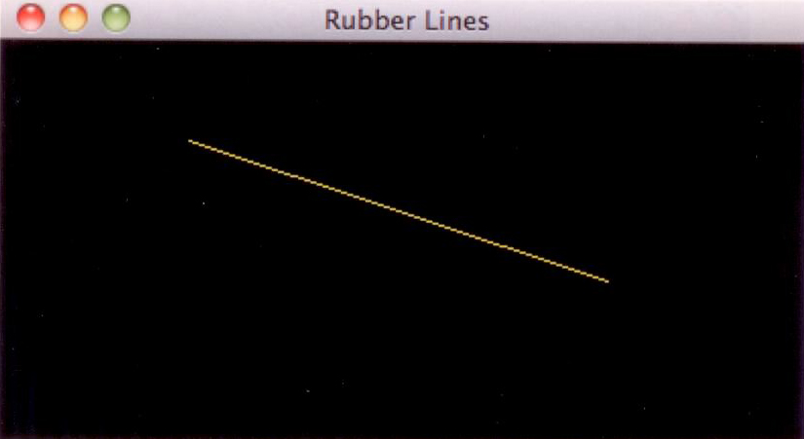
RubberLines Example
As the mouse is dragged, the line is redrawn
This creates a rubberbanding effect, as if the line is being pulled into shape

Slide 98
RubberLines Example
This example uses both mouse and mouse motion events
The initial click is captured using the mouse pressed event
Then the line is updated continually using the mouse dragged event

Slide 99
//********************************************************************
// RubberLines.java Java Foundations
//
// Demonstrates mouse events and rubberbanding.
//********************************************************************
import javax.swing.JFrame;
public class RubberLines
{
//-----------------------------------------------------------------
// Creates and displays the application frame.
//-----------------------------------------------------------------
public static void main(String[] args)
{
JFrame frame = new JFrame("Rubber Lines");
frame.setDefaultCloseOperation(JFrame.EXIT_ON_CLOSE);
frame.getContentPane().add(new RubberLinesPanel());
frame.pack();
frame.setVisible(true);
}
}

Slide 100
//********************************************************************
// RubberLinesPanel.java Java Foundations
//
// Represents the primary drawing panel for the RubberLines program.
//********************************************************************
import javax.swing.JPanel;
import java.awt.*;
import java.awt.event.*;
public class RubberLinesPanel extends JPanel
{
private Point point1 = null, point2 = null;
//-----------------------------------------------------------------
// Constructor: Sets up this panel to listen for mouse events.
//-----------------------------------------------------------------
public RubberLinesPanel()
{
LineListener listener = new LineListener();
addMouseListener(listener);
addMouseMotionListener(listener);
setBackground(Color.black);
setPreferredSize(new Dimension(400, 200));
}

Slide 101
//-----------------------------------------------------------------
// Draws the current line from the intial mouse-pressed point to
// the current position of the mouse.
//-----------------------------------------------------------------
public void paintComponent(Graphics page)
{
super.paintComponent(page);
page.setColor (Color.yellow);
if (point1 != null && point2 != null)
page.drawLine(point1.x, point1.y, point2.x, point2.y);
}
//*****************************************************************
// Represents the listener for all mouse events.
//*****************************************************************
private class LineListener implements MouseListener,
MouseMotionListener
{
//--------------------------------------------------------------
// Captures the initial position at which the mouse button is
// pressed.
//--------------------------------------------------------------
public void mousePressed(MouseEvent event)
{
point1 = event.getPoint();
}

Slide 102
//--------------------------------------------------------------
// Gets the current position of the mouse as it is dragged and
// redraws the line to create the rubberband effect.
//--------------------------------------------------------------
public void mouseDragged(MouseEvent event)
{
point2 = event.getPoint();
repaint();
}
//--------------------------------------------------------------
// Provide empty definitions for unused event methods.
//--------------------------------------------------------------
public void mouseClicked(MouseEvent event) {}
public void mouseReleased(MouseEvent event) {}
public void mouseEntered(MouseEvent event) {}
public void mouseExited(MouseEvent event) {}
public void mouseMoved(MouseEvent event) {}
}
}

Slide 103
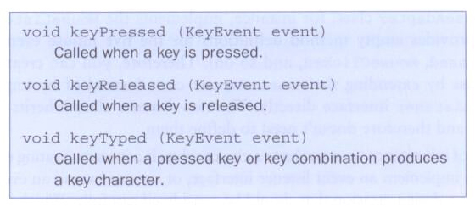
Key Events
A key event is generated when the user presses a keyboard key
This allows a program to respond immediately to the user while they are typing
The KeyListener interface defines three methods used to respond to keyboard activity

Slide 104
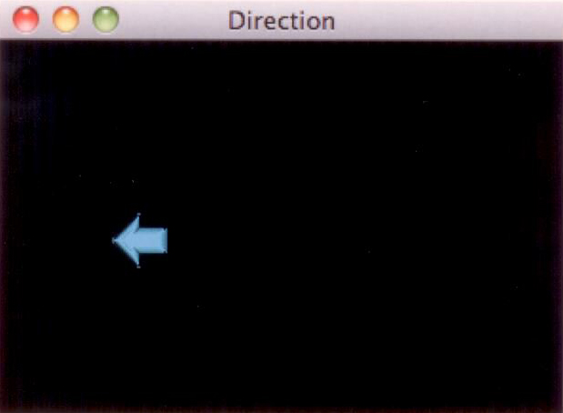
Direction Example
As the user presses the arrow keys on the keyboard, an arrow image is displayed and moved in the appropriate direction

Slide 105
//********************************************************************
// Direction.java Java Foundations
//
// Demonstrates key events.
//********************************************************************
import javax.swing.JFrame;
public class Direction
{
//-----------------------------------------------------------------
// Creates and displays the application frame.
//-----------------------------------------------------------------
public static void main(String[] args)
{
JFrame frame = new JFrame("Direction");
frame.setDefaultCloseOperation(JFrame.EXIT_ON_CLOSE);
frame.getContentPane().add(new DirectionPanel());
frame.pack();
frame.setVisible(true);
}
}

Slide 106
//********************************************************************
// DirectionPanel.java Java Foundations
//
// Represents the primary display panel for the Direction program.
//********************************************************************
import javax.swing.*;
import java.awt.*;
import java.awt.event.*;
public class DirectionPanel extends JPanel
{
private final int WIDTH = 300, HEIGHT = 200;
private final int JUMP = 10; // increment for image movement
private final int IMAGE_SIZE = 31;
private ImageIcon up, down, right, left, currentImage;
private int x, y;
//-----------------------------------------------------------------
// Constructor: Sets up this panel and loads the images.
//-----------------------------------------------------------------
public DirectionPanel()
{
addKeyListener (new DirectionListener());
x = WIDTH / 2;
y = HEIGHT / 2;

Slide 107
up = new ImageIcon("arrowUp.gif");
down = new ImageIcon("arrowDown.gif");
left = new ImageIcon("arrowLeft.gif");
right = new ImageIcon("arrowRight.gif");
currentImage = right;
setBackground(Color.black);
setPreferredSize(new Dimension(WIDTH, HEIGHT));
setFocusable(true);
}
//-----------------------------------------------------------------
// Draws the image in the current location.
//-----------------------------------------------------------------
public void paintComponent(Graphics page)
{
super.paintComponent(page);
currentImage.paintIcon(this, page, x, y);
}

Slide 108
//*****************************************************************
// Represents the listener for keyboard activity.
//*****************************************************************
private class DirectionListener implements KeyListener
{
//--------------------------------------------------------------
// Responds to the user pressing arrow keys by adjusting the
// image and image location accordingly.
//--------------------------------------------------------------
public void keyPressed(KeyEvent event)
{
switch (event.getKeyCode())
{
case KeyEvent.VK_UP:
currentImage = up;
y -= JUMP;
break;
case KeyEvent.VK_DOWN:
currentImage = down;
y += JUMP;
break;
case KeyEvent.VK_LEFT:
currentImage = left;
x -= JUMP;
break;

Slide 109
case KeyEvent.VK_RIGHT:
currentImage = right;
x += JUMP;
break;
}
repaint();
}
//--------------------------------------------------------------
// Provide empty definitions for unused event methods.
//--------------------------------------------------------------
public void keyTyped(KeyEvent event) {}
public void keyReleased(KeyEvent event) {}
}
}

Slide 110
Extending Adapter Classes
In our previous examples, we’ve created the listener classes by implementing a particular listener interface
An alternative technique for creating a listener class is to use inheritance and extend an adapter class
Each listener interface that contains more than one method has a corresponding adapter class containing empty definitions for all methods in the interface
We can override any event methods we need in our new child class

Slide 111
Extending Adapter Classes
For example:
The MouseAdapter class implements the MouseListener interface class and provides empty method definitions for the five mouse event methods
By subclassing MouseAdapter, we can avoid implementing the interface directly
This approach can save coding time and keep source code easier to read

Slide 112
Dialog Boxes
A dialog box is a graphical window that pops up on top of any currently active window so that the user can interact with it
A dialog box can serve a variety of purposes
conveying information
confirming an action
permitting the user to enter information
The JOptionPane class simplifies the creation and use of basic dialog boxes

Slide 113
Dialog Boxes
JOptionPane dialog boxes fall into three categories
message dialog boxes – used to display an output string
input dialog boxes – presents a prompt and a single input txt file into which the user can enter one string of data
confirm dialog box – presents the user with a simple yes-or-no question
These three types of dialog boxes are created using static methods in the JOptionPane class
Many of the JOptionPane methods allow the program to tailor the contents of the dialog box

Slide 114
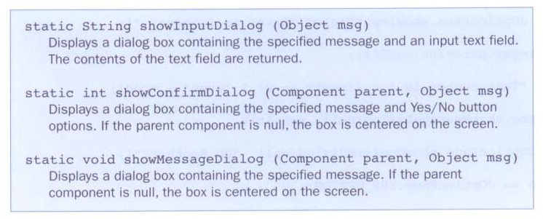
JOptionPane Methods

Slide 115
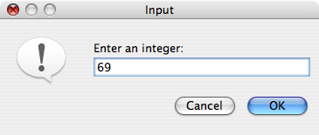
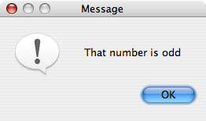
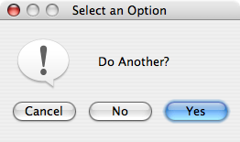
EvenOdd Example
Determines if an integer is even or odd
Instead of a single frame, it uses three dialog boxes

Slide 116
//********************************************************************
// EvenOdd.java Java Foundations
//
// Demonstrates the use of the JOptionPane class.
//********************************************************************
import javax.swing.JOptionPane;
public class EvenOdd
{
//-----------------------------------------------------------------
// Determines if the value input by the user is even or odd.
// Uses multiple dialog boxes for user interaction.
//-----------------------------------------------------------------
public static void main(String[] args)
{
String numStr, result;
int num, again;
do
{
numStr = JOptionPane.showInputDialog("Enter an integer: ");
num = Integer.parseInt(numStr);
result = "That number is " + ((num%2 == 0) ? "even" : "odd");

Slide 117
JOptionPane.showMessageDialog(null, result);
again = JOptionPane.showConfirmDialog(null, "Do Another?");
}
while (again == JOptionPane.YES_OPTION);
}
}

Slide 118
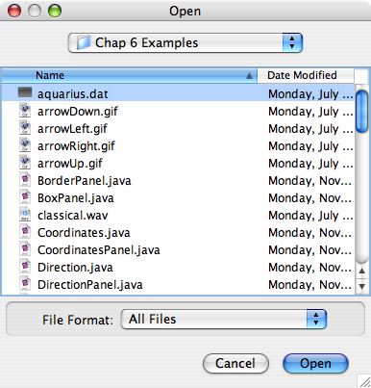
File Choosers
A file chooser is a specialized dialog box used to select a file from a disk or other storage medium
The dialog automatically presents a standardized file selection window
Filters can be applied to the file chooser programmatically
The JFileChooser class creates this type of dialog box

Slide 119
//********************************************************************
// DisplayFile.java Java Foundations
//
// Demonstrates the use of a file chooser and a text area.
//********************************************************************
import java.util.Scanner;
import java.io.*;
import javax.swing.*;
public class DisplayFile
{
//-----------------------------------------------------------------
// Opens a file chooser dialog, reads the selected file and
// loads it into a text area.
//-----------------------------------------------------------------
public static void main(String[] args) throws IOException
{
JFrame frame = new JFrame("Display File");
frame.setDefaultCloseOperation(JFrame.EXIT_ON_CLOSE);
JTextArea ta = new JTextArea(20, 30);
JFileChooser chooser = new JFileChooser();
int status = chooser.showOpenDialog(null);

Slide 120
if (status != JFileChooser.APPROVE_OPTION)
ta.setText("No File Chosen");
else
{
File file = chooser.getSelectedFile();
Scanner scan = new Scanner(file);
String info = "";
while (scan.hasNext())
info += scan.nextLine() + "\n";
ta.setText(info);
}
frame.getContentPane().add(ta);
frame.pack();
frame.setVisible(true);
}
}

Slide 121
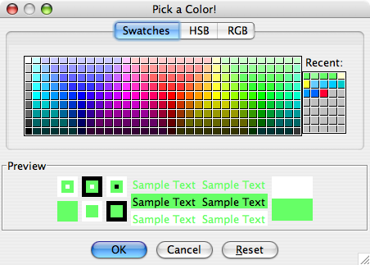
Color Choosers
A color chooser dialog box can be displayed, permitting the user to select color from a list
The JColorChooser represents a color chooser dialog box
The user can also specify a color using RGB values

Slide 122
Borders
Java provides the ability to put a border around any Swing component
A border is not a component but defines how the edge of a component should be drawn
Border provide visual cues as to how GUI components are organized
The BorderFactory class is useful for creating borders for components

Slide 123
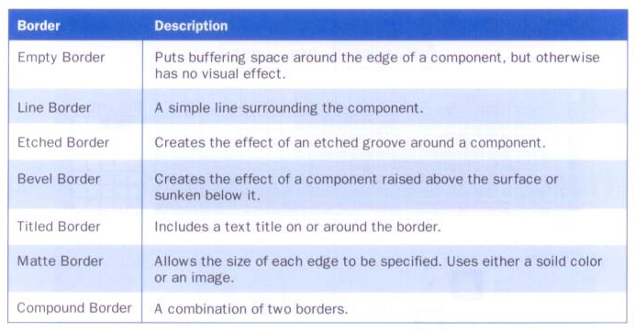
Borders
Some borders that can be defined using the BorderFactory class:

Slide 124
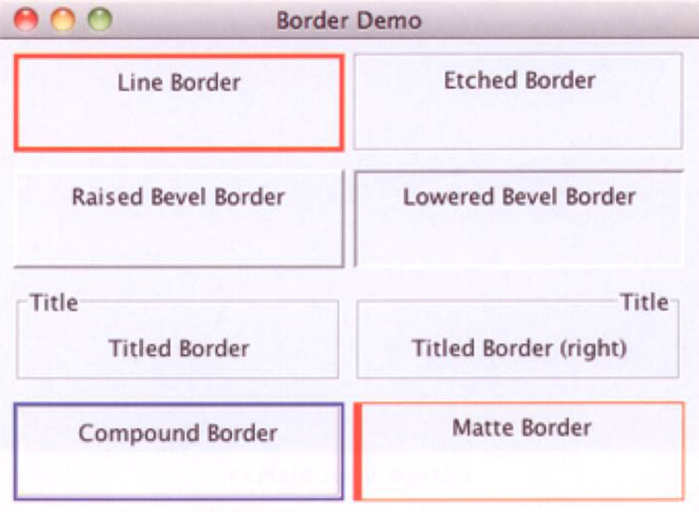
BorderDemo Example
Displays several small panels with various borders

Slide 125
//********************************************************************
// BorderDemo.java Java Foundations
//
// Demonstrates the use of various types of borders.
//********************************************************************
import java.awt.*;
import javax.swing.*;
import javax.swing.border.*;
public class BorderDemo
{
//-----------------------------------------------------------------
// Creates several bordered panels and displays them.
//-----------------------------------------------------------------
public static void main (String[] args)
{
JFrame frame = new JFrame("Border Demo");
frame.setDefaultCloseOperation(JFrame.EXIT_ON_CLOSE);
JPanel panel = new JPanel();
panel.setLayout(new GridLayout(0, 2, 5, 10));
panel.setBorder(BorderFactory.createEmptyBorder(8, 8, 8, 8));
JPanel p1 = new JPanel();
p1.setBorder(BorderFactory.createLineBorder(Color.red, 3));
p1.add(new JLabel("Line Border"));
panel.add(p1);

Slide 126
JPanel p2 = new JPanel();
p2.setBorder(BorderFactory.createEtchedBorder());
p2.add(new JLabel("Etched Border"));
panel.add(p2);
JPanel p3 = new JPanel();
p3.setBorder(BorderFactory.createRaisedBevelBorder());
p3.add(new JLabel("Raised Bevel Border"));
panel.add(p3);
JPanel p4 = new JPanel();
p4.setBorder(BorderFactory.createLoweredBevelBorder());
p4.add(new JLabel("Lowered Bevel Border"));
panel.add(p4);
JPanel p5 = new JPanel();
p5.setBorder(BorderFactory.createTitledBorder("Title"));
p5.add(new JLabel("Titled Border"));
panel.add(p5);
JPanel p6 = new JPanel();
TitledBorder tb = BorderFactory.createTitledBorder("Title");
tb.setTitleJustification(TitledBorder.RIGHT);
p6.setBorder(tb);
p6.add(new JLabel("Titled Border (right)"));
panel.add (p6);

Slide 127
JPanel p7 = new JPanel();
Border b1 = BorderFactory.createLineBorder(Color.blue, 2);
Border b2 = BorderFactory.createEtchedBorder();
p7.setBorder (BorderFactory.createCompoundBorder(b1, b2));
p7.add (new JLabel("Compound Border"));
panel.add(p7);
JPanel p8 = new JPanel();
Border mb = BorderFactory.createMatteBorder(1, 5, 1, 1,
Color.red);
p8.setBorder(mb);
p8.add(new JLabel("Matte Border"));
panel.add(p8);
frame.getContentPane().add (panel);
frame.pack();
frame.setVisible(true);
}
}

Slide 128
Tool Tips
A tool tip is a short line of text that appears over a component when the mouse cursor is rested momentarily on top of the component
Tool tips usually inform the user about the component
Tool tips can be assigned by using the setToolTipText method of a component
JButton button = new Button(“Compute”);
button.setToolTipText(“Calculates the area under the curve”);

Slide 129
Mnemonics
A mnemonic is a character that allows the user to push a button or make a menu choice using the keyboard in addition to the mouse
For example, when a mnemonic has been defined for a button, the user can hold down the Alt key and press the mnemonic character to activate (depress) the button
We set the mnemonic for a component using the setMnemonic method of the component
A character in the label may be underlined to indicate that it can be used as a shortcut

Slide 130
Disabling Components
A component can be disabled to indicate it should not (cannot) be used
A disabled component is usually "greyed out"
This helps guide the user

Slide 131
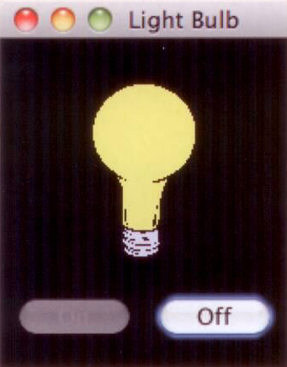
LightBulb Example
Tool tips, mnemonics, and disabled components are used in this example
It displays an "on" or "off" bulb depending on which button is pressed

Slide 132
//********************************************************************
// LightBulb.java Java Foundations
//
// Demonstrates mnemonics and tool tips.
//********************************************************************
import javax.swing.*;
import java.awt.*;
public class LightBulb
{
//-----------------------------------------------------------------
// Sets up a frame that displays a light bulb image that can be
// turned on and off.
//-----------------------------------------------------------------
public static void main(String[] args)
{
JFrame frame = new JFrame("Light Bulb");
frame.setDefaultCloseOperation(JFrame.EXIT_ON_CLOSE);
LightBulbPanel bulb = new LightBulbPanel();
LightBulbControls controls = new LightBulbControls (bulb);
JPanel panel = new JPanel();
panel.setBackground(Color.black);
panel.setLayout(new BoxLayout(panel, BoxLayout.Y_AXIS));

Slide 133
panel.add(Box.createRigidArea (new Dimension (0, 20)));
panel.add(bulb);
panel.add(Box.createRigidArea (new Dimension (0, 10)));
panel.add(controls);
panel.add(Box.createRigidArea (new Dimension (0, 10)));
frame.getContentPane().add(panel);
frame.pack();
frame.setVisible(true);
}
}

Slide 134
//********************************************************************
// LightBulbPanel.java Java Foundations
//
// Represents the image for the LightBulb program.
//********************************************************************
import javax.swing.*;
import java.awt.*;
public class LightBulbPanel extends JPanel
{
private boolean on;
private ImageIcon lightOn, lightOff;
private JLabel imageLabel;
//-----------------------------------------------------------------
// Constructor: Sets up the images and the initial state.
//-----------------------------------------------------------------
public LightBulbPanel()
{
lightOn = new ImageIcon("lightBulbOn.gif");
lightOff = new ImageIcon("lightBulbOff.gif");
setBackground(Color.black);
on = true;
imageLabel = new JLabel(lightOff);
add(imageLabel);
}

Slide 135
//-----------------------------------------------------------------
// Paints the panel using the appropriate image.
//-----------------------------------------------------------------
public void paintComponent(Graphics page)
{
super.paintComponent(page);
if (on)
imageLabel.setIcon(lightOn);
else
imageLabel.setIcon(lightOff);
}
//-----------------------------------------------------------------
// Sets the status of the light bulb.
//-----------------------------------------------------------------
public void setOn(boolean lightBulbOn)
{
on = lightBulbOn;
}
}

Slide 136
//********************************************************************
// LightBulbControls.java Java Foundations
//
// Represents the control panel for the LightBulb program.
//********************************************************************
import javax.swing.*;
import java.awt.*;
import java.awt.event.*;
public class LightBulbControls extends JPanel
{
private LightBulbPanel bulb;
private JButton onButton, offButton;
//-----------------------------------------------------------------
// Sets up the lightbulb control panel.
//-----------------------------------------------------------------
public LightBulbControls(LightBulbPanel bulbPanel)
{
bulb = bulbPanel;
onButton = new JButton("On");
onButton.setEnabled(false);
onButton.setMnemonic('n');
onButton.setToolTipText("Turn it on!");
onButton.addActionListener(new OnListener());

Slide 137
offButton = new JButton("Off");
offButton.setEnabled(true);
offButton.setMnemonic('f');
offButton.setToolTipText("Turn it off!");
offButton.addActionListener(new OffListener());
setBackground(Color.black);
add(onButton);
add(offButton);
}
//*****************************************************************
// Represents the listener for the On button.
//*****************************************************************
private class OnListener implements ActionListener
{
//--------------------------------------------------------------
// Turns the bulb on and repaints the bulb panel.
//--------------------------------------------------------------
public void actionPerformed(ActionEvent event)
{
bulb.setOn(true);
onButton.setEnabled(false);
offButton.setEnabled(true);
bulb.repaint();
}
}

Slide 138
//*****************************************************************
// Represents the listener for the Off button.
//*****************************************************************
private class OffListener implements ActionListener
{
//--------------------------------------------------------------
// Turns the bulb off and repaints the bulb panel.
//--------------------------------------------------------------
public void actionPerformed(ActionEvent event)
{
bulb.setOn(false);
onButton.setEnabled(true);
offButton.setEnabled(false);
bulb.repaint();
}
}
}

Slide 139
GUI Design
Keep in mind our goal is to solve a problem
Fundamental ideas of good GUI design include
knowing the user
preventing user errors
optimizing user abilities
being consistent
We should design interfaces so that the user can make as few mistakes as possible

